Slide 1
COPADS
#4 – Intermediate Threading
IFEOLUWATAYO IGE

Slide 2
OUTLINE
Project 1 This Week: File Count!
I will wait for 10 minutes before the end of each class to answer questions until “two days from when it is due. Kindly refer to the syllabus!
Let’s discuss high-level questions, clarifications, and even pseudocode.
Sorry, no code presentation to ensure fairness and equity with your other course mates
Race Condition
Achieving Mutual Exclusion
Producer-Consumer problem and solutions
C# and Threads
Monitor class
Reader-Writer problem

Slide 3
Race Condition
During the execution of instructions by multiple threads/processes, it may become necessary to access shared memory, and files at the same time which could lead to several race conditions.
An example could be reading or writing some shared data.
That part of the program code where the shared memory is accessed is called the critical region or critical section.
Race condition occurs when two or more threads/processes in their critical regions are attempting to access some shared resource simultaneously.
Example: Two processes in an airline reservation system each trying to grab the last seat on a plane for different customers
Solution to race condition? Mutual exclusion when in the critical region. This ensures that if one process uses a shared variable or file, the other processes are excluded from assessing the same.

Slide 4
Four major conditions must be put in place to avoid race condition:
No two processes may be simultaneously inside their critical regions (Mutual Exclusion).
No assumptions may be made about speeds or the number of CPUs.
No process running outside its critical region may block any process.
No process should have to wait forever to enter its critical region

Slide 5
Achieving Mutual Exclusion: Disabling Interrupts
Have each process disable all interrupts just after entering its critical region and re-enable them just before leaving it.
No clock interrupts can occur as the CPU is only switched from process to process because of a clock or other interrupts
Thus, once a process has disabled interrupts, it can access, and update the shared memory without fear that any other process will intervene.
Problem with this approach?
It is unwise to give user processes the power to turn off interrupts. What if one of them did it, and never turned them on again?
Approach may only work for single processor systems. For multiprocessor systems, disabling interrupts affects only the CPU that executes the disabled instruction. The other ones will continue running and may access the shared memory (we wanted to avoid this).

Slide 6
Achieving Mutual Exclusion: Shared Variable
Consider having a single, shared variable (Mutex), initially 0.
When a process wants to enter its critical region, it first checks the shared variable. If it is 0, the process sets it to 1 and enters the critical region.
If the shared variable is already 1, the process just waits until it becomes 0.
Thus, a 0 means that no process is in its critical region, and a 1 means that some process is in its critical region
Problem with this approach?
Suppose that one thread reads the variable and sees that it is 0. Also, let’s assume that before it is able to set it to 1, another thread is scheduled from another core, sets the variable to 1, and enters its critical region.
The first process will also set the variable to 1 since it initially read the variable as having 0,
Then, two processes will be in their critical regions simultaneously. Race condition?
A problem could also exist if two threads attempt to claim two resources but have the associated mutexes in different orders. For example, if threads A and B have mutexes 1 and 2 respectively, a deadlock occurs when each attempts to have the mutex held by the other.

Slide 7
Example: Producer-Consumer Problem
Two processes share a common, fixed-size buffer. One of them, the producer, puts items into the buffer, and the other one, the consumer, takes it out.
They both share a common buffer and attempt to access the buffer
The following issues could arise:
Data Inconsistency: When the producer is producing the data and adding to the buffer, the consumer may interfere in between or vice versa.
Buffer “Underflow/Overflow”: The consumer may attempt to remove data when the buffer is empty. Similarly, the producer may insert data when the buffer is full.
Example: Building a fork dispenser for a restaurant

Slide 8
Solution 1: When the buffer is full, just discard all new items the producer produces.
Any Con?
Seems stupid and inefficient but could be used:
When you have a producer producing tasks that have timeouts, especially when the timeouts are set by some third-party data provider.
The time starts even before the consumer actually creates a task to start consuming each item, so sleeping is not an option.
If the queue is quickly filled up, it is unlikely that the consumer will consume all the stuff in time
Even if the queue is increased, every single time they are both scheduled to run, the consumer will not always complete its tasks before the timeout.

Slide 9
Solution 2: Sleep and Wake
we will need a variable “count” set to a maximum number say N. If the maximum number of items the buffer can hold is N, the producer’s code will first test to see if the count is N.
If it is, the producer will go to sleep; if it is not, the producer will add an item and increment the “count”.
The consumer’s code is similar: first test count to see if it is 0. If it is, go to sleep; if it is nonzero, remove an item and decrement the counter.
Could you think of any con if this method is used?

Slide 10
Deadlock! Suppose:
Consumer sees count to be 0, but just before calling sleep(), the consumer is interrupted by some priority thread.
Meanwhile, when count is 0, the scheduler immediately initiates the producer to produce at least 1 in the buffer, and increments count to 1.
Producer then sends wakeup call to consumer to wake up since count is now 1. However, the consumer was temporarily moved to a ready state (idle) due to preemption and has not yet slept… The wake-up call is therefore lost as wakeup calls are only sent to blocked threads (sleeping)
Consumer is rescheduled much later, continues execution and will eventually sleep since count was 0 before the preemption.
Producer will continue to produce and when the buffer is full, it will also sleep
Both will sleep forever…,

Slide 11
Solution 3: Counting Semaphores
Are variables that have a non-negative value associated with it
The value is incremented and decremented atomically
Semaphore has a positive value initially and offers two atomic operations
Down(): When “value” is positive, atomically decrement it by 1. Block the calling thread if value is 0 and “wait” for the semaphore value to become positive.
Up(): Atomically increment the semaphore value by 1 if “value” is less than “max”. Wake up a thread waiting if any. Else, Thread “waits” for the semaphore value to become less than “max”.

Slide 12
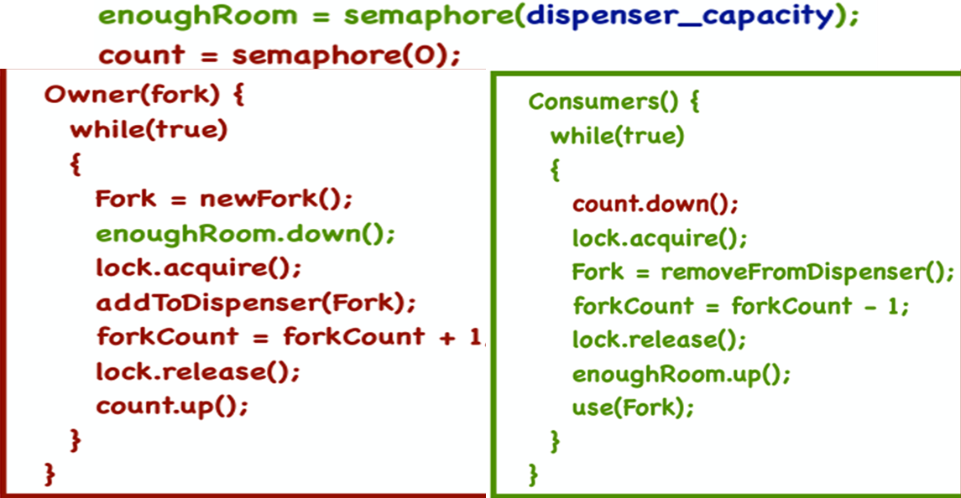
Synchronization Issues may Arise!
Producer is producing fork and altering semaphore before acquiring lock??? What if the lock has been acquired by the consumer?
This may also apply to the consumer code too!

Slide 13
Solution 4: Condition Variables
These variables use a mechanism to enable threads to wait/sleep inside a critical section (if they have acquired the lock, they should still be able to release it for a legitimate reason).
Three major operations on conditional variable X:
X.Wait(lock): Releases lock and puts a thread to sleep until signaled. When awakened, it reacquires the lock
X. Signal/Notify(): Wakes up one of the threads waiting on X. The caller thread must currently have the lock when this method is called.
X. Broadcast/NotifyAll(): Same as notify, except it wakes up all waiting threads.

Slide 14
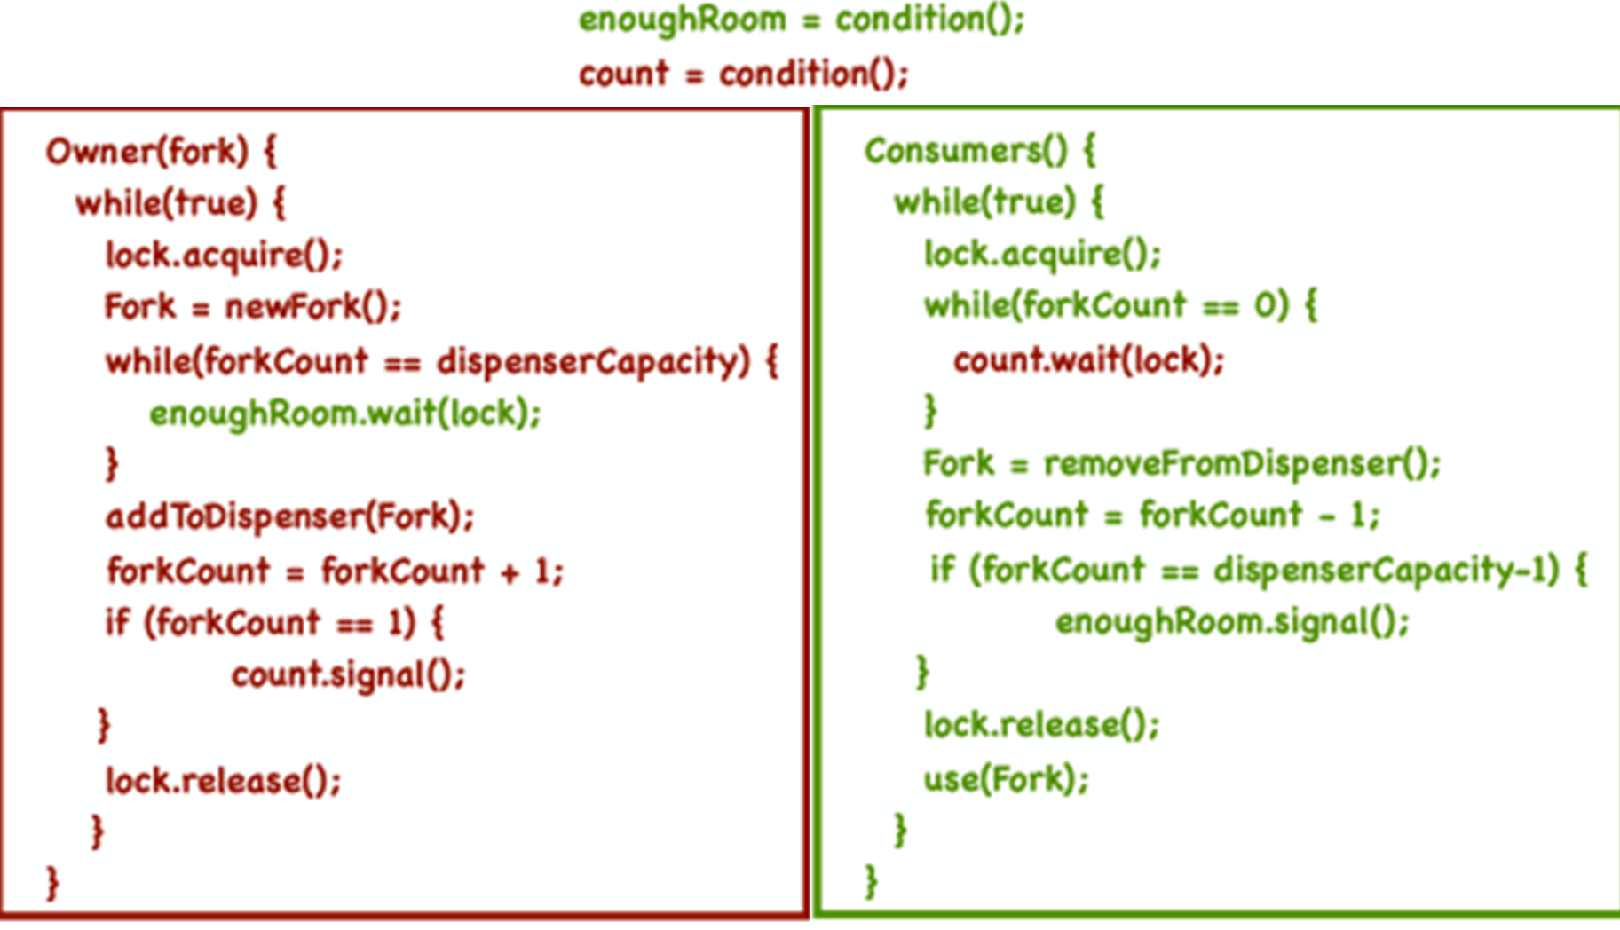

Slide 15
Condition Variables Or Semaphores?
wait(lock) versus down()
down() blocks threads only if value is 0
wait(lock) always blocks, and gives up lock
notify(lock) versus up()
notify(lock) is stateless: when called, if there is no waiting thread, no operation is performed
up() is stateful: when called, it increments the semaphore, and waiting threads can call a down().
If there is no waiting thread, up() ensures future threads do not wait on down(). This is because some memory of the earlier up() call is kept which was meant to increment the semaphore.

Slide 16
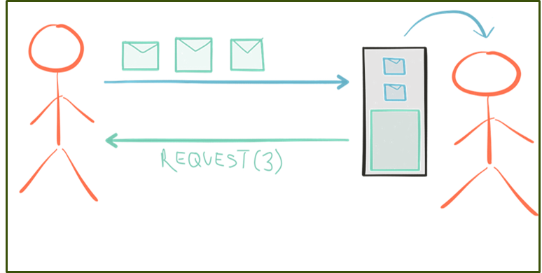
Solution 5: Reactive Streams via Programming
A reactive stream is a bi-directional flow of data on demand consisting of:
Elements emitted downstream from producer to consumer, and
A signal for demand which may be emitted upstream from consumer to producer.
If the consumer is placed in charge of signaling demand, the publisher is free to safely push up to the number of elements demanded.
Reactive Streams works like a pull-based system when the consumer is slower (because it prevents a fast producer from running at full speed) and a push-based system when the consumer is faster. This is dynamic and changes in near real-time.
See Diagram: The consumer actually tells the producer information about its throughput. Probably the number of tasks he is ready to consume at the moment, or the number of tasks he can consume per second…,
Implementations:
Reactive Extensions for .NET
Scala (Java without the semi-colon☺☺)
https://blog.redelastic.com/a-journey-into-reactive-streams-5ee2a9cd7e29
https://github.com/dotnet/reactive?tab=readme-ov-file

